Slide 1

“CHILDREN, ESPECIALLY GIRLS AGED 2-12 HAVE ACCESS TO QUALITY EDUCATION WITH IMPROVED INFRASTRUCTURE AND SAFE LEARNING ENVIRONMENT”
Prepared By: ITA Shikarpur.

Slide 2
Components of ITA
School Improvement Program in 105 Schools (22 Schools Physically Rehabilitated)
ECD Center / Pahnjo Verho
Learning 4 Access (Piloting Program)
Telenor (I-Champ)
Healthy Pakistan Mission (Unilever Pakistan)
ASER(Annual Status of Education Report)

Slide 3
“CHILDREN, ESPECIALLY GIRLS AGED 2-12 HAVE ACCESS TO QUALITY EDUCATION WITH IMPROVED INFRASTRUCTURE AND SAFE LEARNING ENVIRONMENT”
Outcome 1:
Children have access to improved infrastructure and safe learning environment
Output 1.2
105 schools are supplied with learning materials, furniture and Para Teachers
For implementation of improved infrastructure and safe learning environment ITA has provided missing facilities & furniture in 22 targeted schools as per need of schools.

Slide 4
“CHILDREN, ESPECIALLY GIRLS AGED 2-12 HAVE ACCESS TO QUALITY EDUCATION WITH IMPROVED INFRASTRUCTURE AND SAFE LEARNING ENVIRONMENT”
Outcome 1:
Children have access to improved infrastructure and safe learning environment
Output 1.2
105 schools are supplied with learning materials, furniture and Para Teachers
Appointment of 40 Para-teachers
To ensure quality of education we provided temporary teachers to provide support in our partner school.

Slide 5
“CHILDREN, ESPECIALLY GIRLS AGED 2-12 HAVE ACCESS TO QUALITY EDUCATION WITH IMPROVED INFRASTRUCTURE AND SAFE LEARNING ENVIRONMENT”
Outcome 1:
Children have access to improved infrastructure and safe learning environment
Output 1.2
105 schools are supplied with learning materials, furniture and Para Teachers
Reading Kit, ECE kits, Health kits & Sports kits were distributed in all 105 partner schools
Science kits were provided in 20 schools

Slide 6
“CHILDREN, ESPECIALLY GIRLS AGED 2-12 HAVE ACCESS TO QUALITY EDUCATION WITH IMPROVED INFRASTRUCTURE AND SAFE LEARNING ENVIRONMENT”
Outcome 2:
Issues relating quality of education are addressed
Output 2.1 210 schools’ teachers and school councils provided quality inputs for learning, ECE, DRR, hygiene, life skills and environmental education
    Six days Subject Base Training on English, Math and Science
Two days Training on Health & Hygiene Training
Two days Training on Early Childhood Education
Two days Training on Disaster Risk Reduction
210 PSTs and Para teachers were trained in that Training.
3 days Annual School Planning training was conducted.
4 days SMC training was conducted and 1 H.T and 1 SMC member was trained from all 105 schools.

Slide 7
“CHILDREN, ESPECIALLY GIRLS AGED 2-12 HAVE ACCESS TO QUALITY EDUCATION WITH IMPROVED INFRASTRUCTURE AND SAFE LEARNING ENVIRONMENT”
Outcome 2:
Issues relating quality of education are addressed
Output 2.2
School Enrichments Programs
Summer School 2012-13
As part of a non-academic, positive learning experience, summer school provide a safe environment where children can develop self-confidence, social skills, and good work habits while still allowing them to be “kids” having fun.
Summer School was conducted in 2 Schools

Slide 8
“CHILDREN, ESPECIALLY GIRLS AGED 2-12 HAVE ACCESS TO QUALITY EDUCATION WITH IMPROVED INFRASTRUCTURE AND SAFE LEARNING ENVIRONMENT”
Outcome 2:
Issues relating quality of education are addressed
Output 2.3
School Enrichments Programs
Life Skills Sessions
Life skill sessions were conducted in targeted schools in which Education promoters told to the children about different life skills.
Personal hygiene
Cleanliness
Speak the truth
Obeying elders
Punctuality etc.

Slide 9
“CHILDREN, ESPECIALLY GIRLS AGED 2-12 HAVE ACCESS TO QUALITY EDUCATION WITH IMPROVED INFRASTRUCTURE AND SAFE LEARNING ENVIRONMENT”
Outcome 3: Catch Up Program for out of school children
Outcome
Output 3.1 catch up program for 1000 vulnerable children 8-12 in afternoons
Catch up program was for those children who were never enrolled or dropped out for some reasons. It was an afternoon program to enhance reading capability of children and to mainstream them in respective classes or level. It was conducted in Mureed Sethar on basis of ASER results.

Slide 10
“CHILDREN, ESPECIALLY GIRLS AGED 2-12 HAVE ACCESS TO QUALITY EDUCATION WITH IMPROVED INFRASTRUCTURE AND SAFE LEARNING ENVIRONMENT”
Component 2: Targeting 3000 children in affected Districts of Punjab & Sindh (minimum 20 schools) with essential basic school and educational materials (Back to School Kits) to enable quality learning
Output 4.1 3000 worst affected children provided full school kits including, bags, stationery, shoes and uniforms
    Children in affected areas supported with uniforms, bags, stationary
1600 School kits were distribution in 10 schools(Uniform, Sweaters, shoes, notebooks, Bag etc.)

Slide 11
“CHILDREN, ESPECIALLY GIRLS AGED 2-12 HAVE ACCESS TO QUALITY EDUCATION WITH IMPROVED INFRASTRUCTURE AND SAFE LEARNING ENVIRONMENT”
Component 3: Construction of 15 ECD Centers catering to 3000 children (Ages: 6 months to 6 years) with support for health, hygiene, life skills; ECD learning, recreation and nutrition training for mothers and care givers
Outcome 5: 15 ECD Center establish for Readiness skills provided for children3-4, enabling them to enroll & persist in local schools
    We have started 04 ECD Centers (PVs), Makka, Kundo Uner, Zarkhel, Fathpur and they are going well. To enroll children and meeting with mothers were conducted in respective villages.

Slide 12
“CHILDREN, ESPECIALLY GIRLS AGED 2-12 HAVE ACCESS TO QUALITY EDUCATION WITH IMPROVED INFRASTRUCTURE AND SAFE LEARNING ENVIRONMENT”
International Days Celebration
    Literacy Walk on “International Literacy Day” 8th September 2012
    Global Action week
    World Teachers Day.

Slide 13
“CHILDREN, ESPECIALLY GIRLS AGED 2-12 HAVE ACCESS TO QUALITY EDUCATION WITH IMPROVED INFRASTRUCTURE AND SAFE LEARNING ENVIRONMENT”
Achievements
    Students enrollment is increased 9%
    22 schools physically rehabilitated
    After training teaching methods and techniques are changed
    The school are improved in health and hygiene environment.
    Close coordination with Education Department.

Slide 14
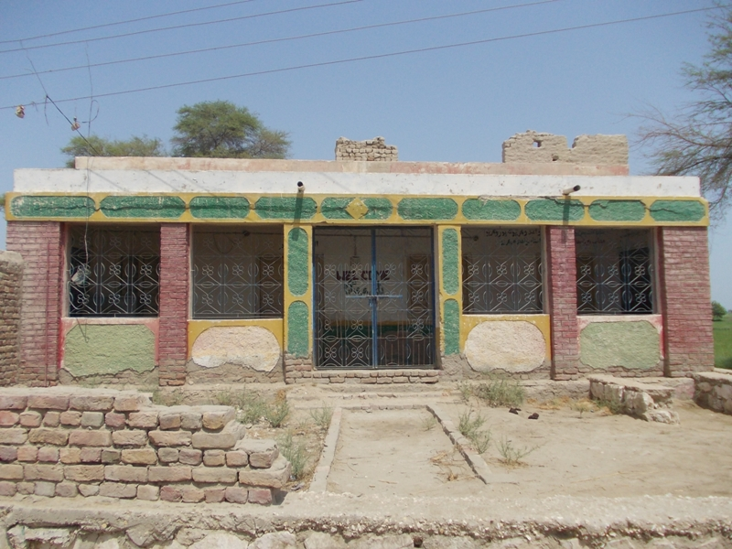
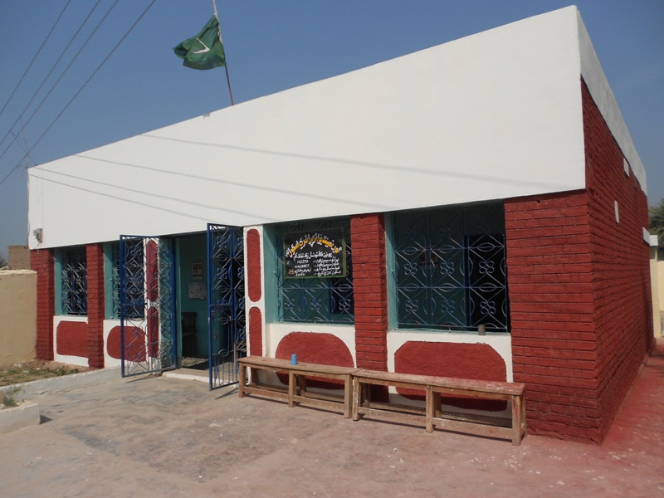
“CHILDREN, ESPECIALLY GIRLS AGED 2-12 HAVE ACCESS TO QUALITY EDUCATION WITH IMPROVED INFRASTRUCTURE AND SAFE LEARNING ENVIRONMENT”
GBPS TEENDA
Pre-Picture
Post-Picture

Slide 15
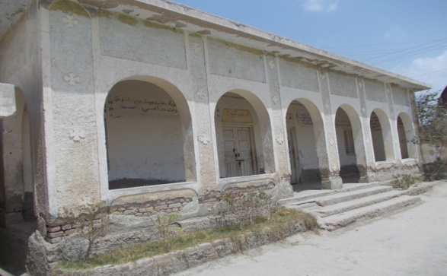
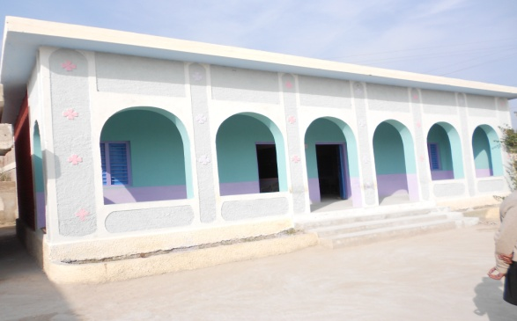
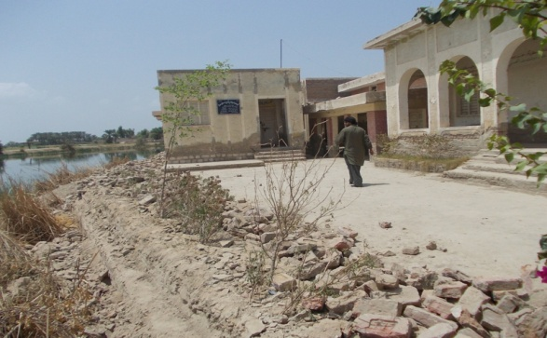
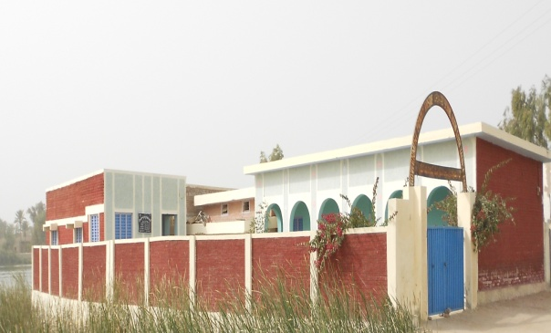
Pre Pictures
Post Pictures
Page 1

Slide 16
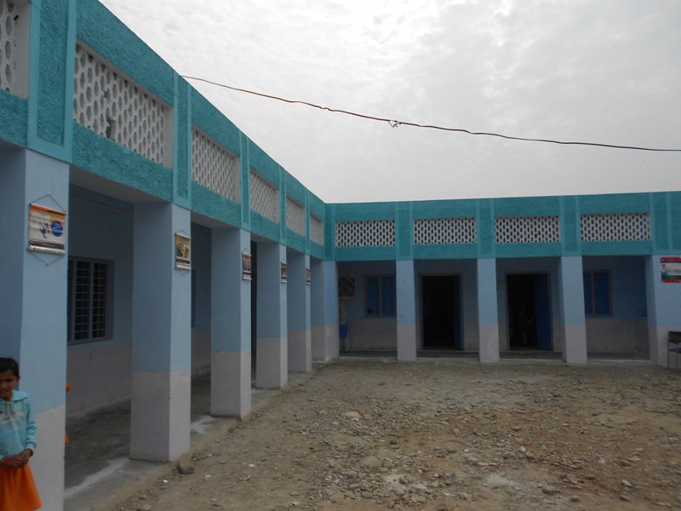
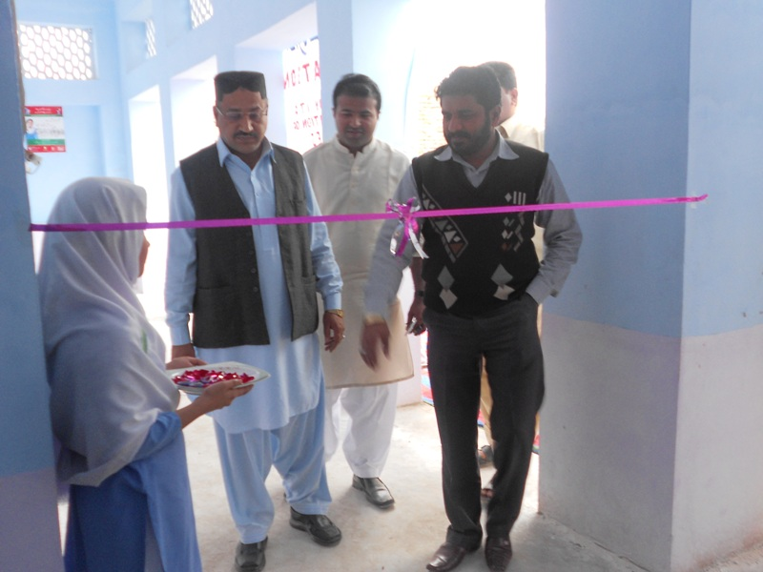
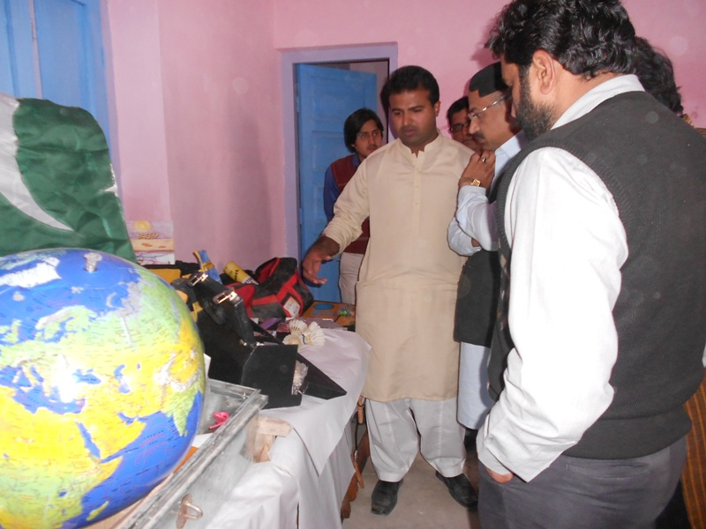
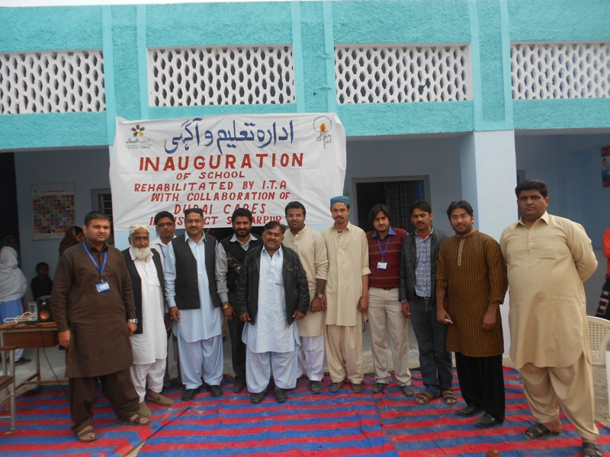
Inauguration GGPS Kirri Nawab Khan
Inauguration ceremony of GGPS Kirri Nawab Khan was held on 2nd February, 2013 in District Shikarpur.
Page 1

Slide 17
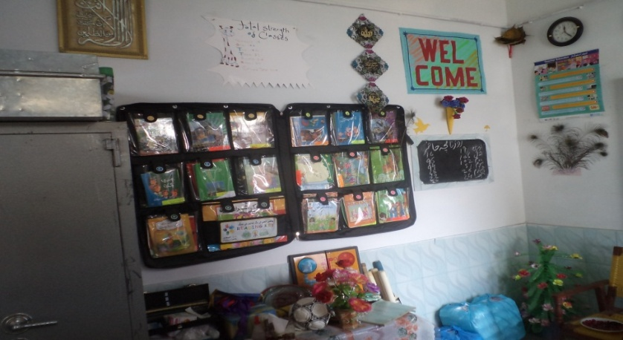
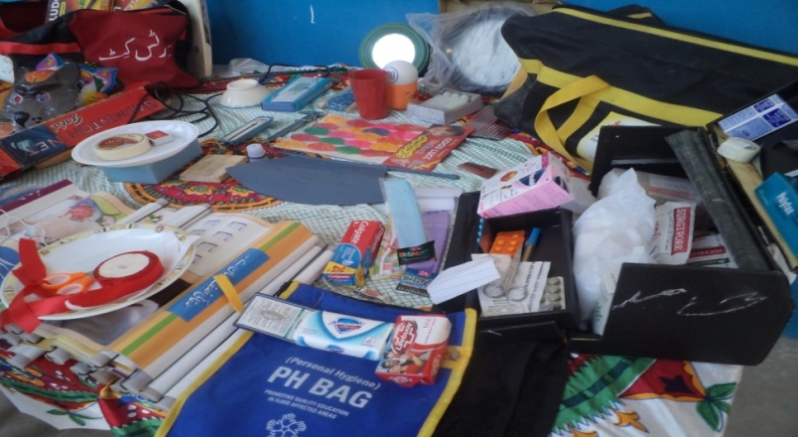
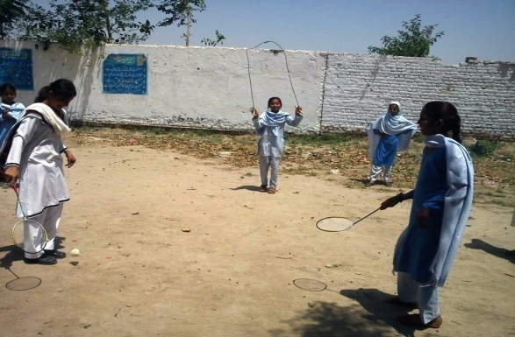
Pictorial View Of Kits
Reading Kit
Health Kit
Sports Kit

Slide 18
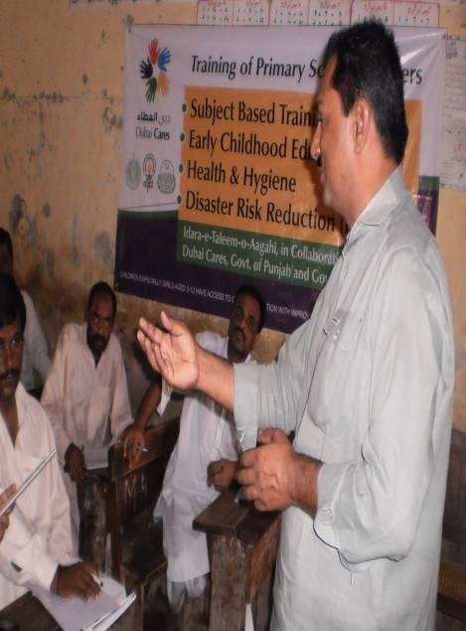
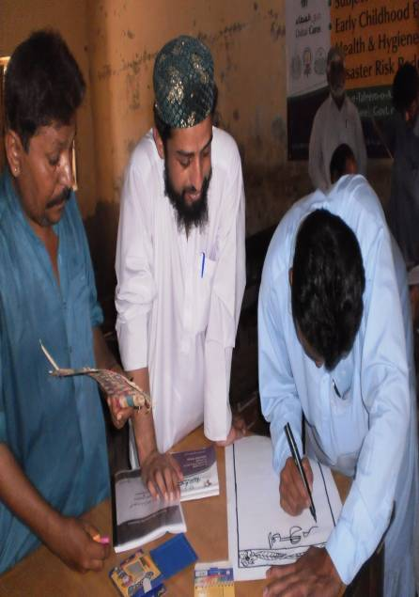
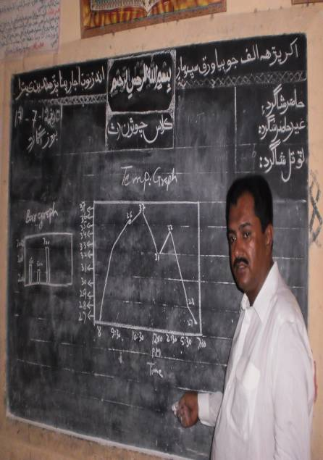
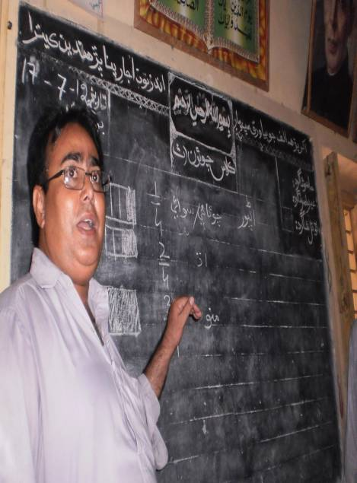
“CHILDREN, ESPECIALLY GIRLS AGED 2-12 HAVE ACCESS TO QUALITY EDUCATION WITH IMPROVED INFRASTRUCTURE AND SAFE LEARNING ENVIRONMENT”
2 Weeks Training

Slide 19
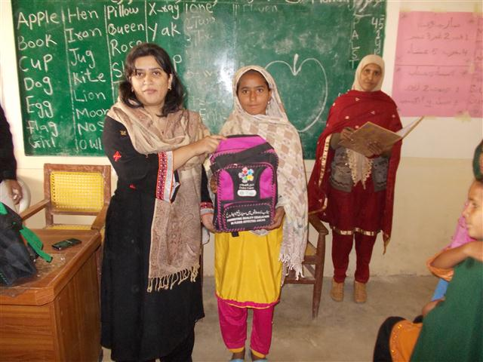
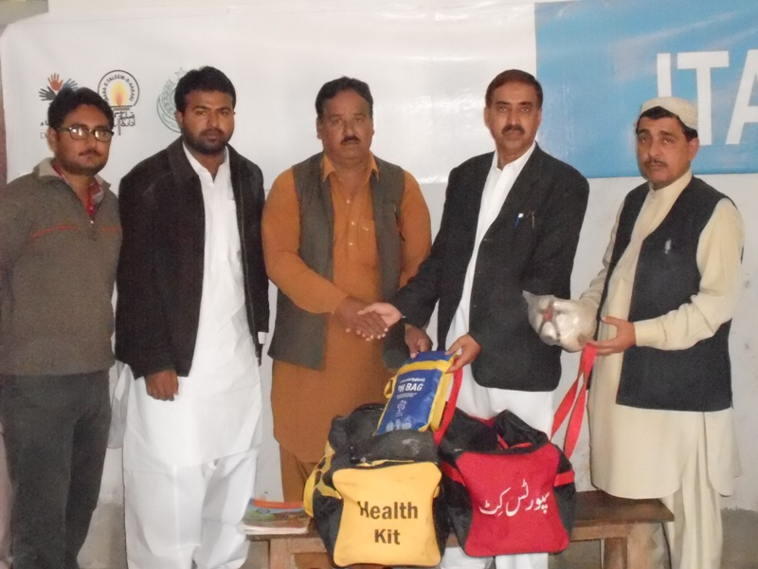
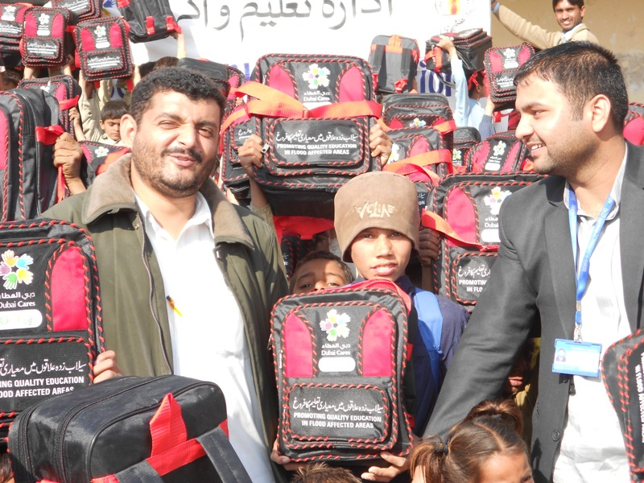
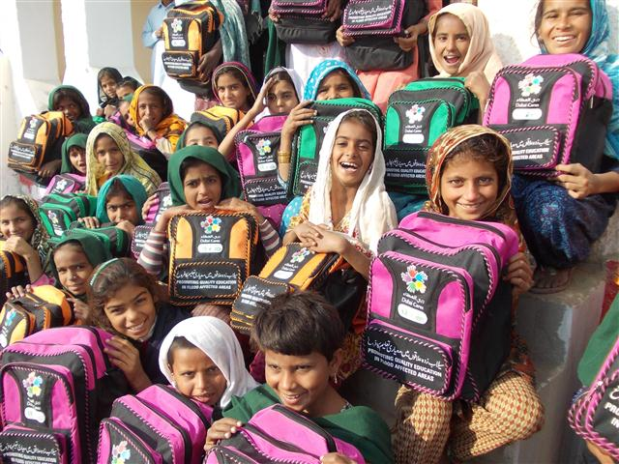
Student Kits Distributed So Far in 10 Schools of
District Shikarpur

Slide 20
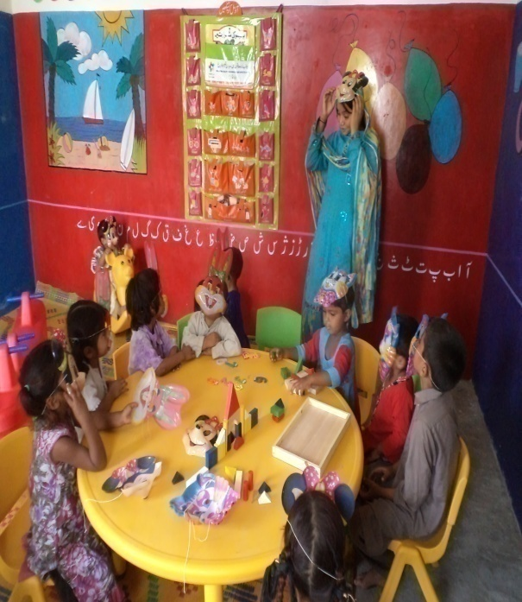
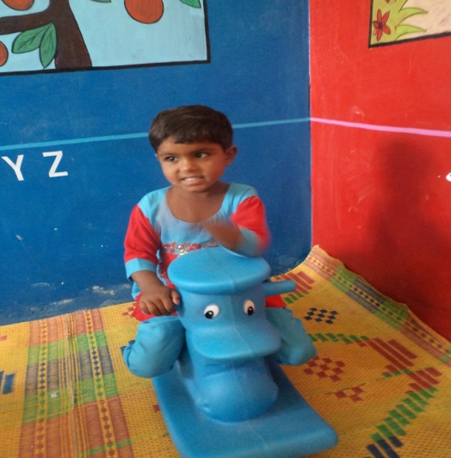
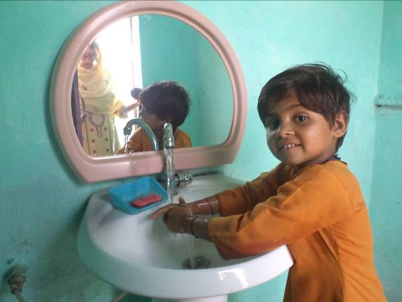
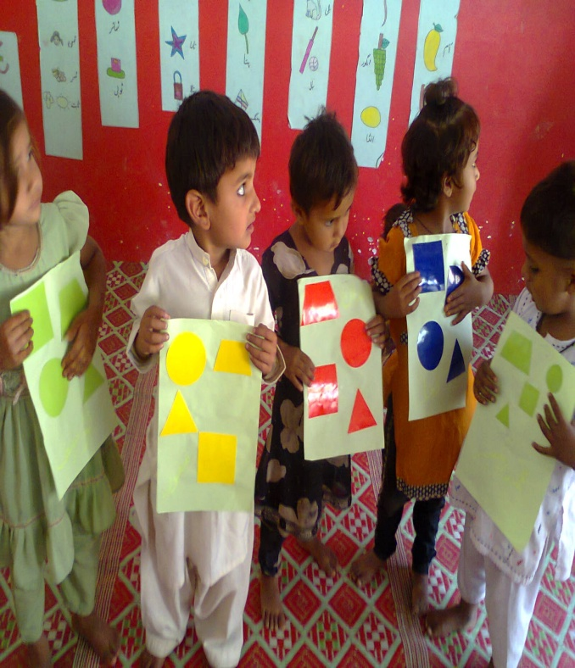
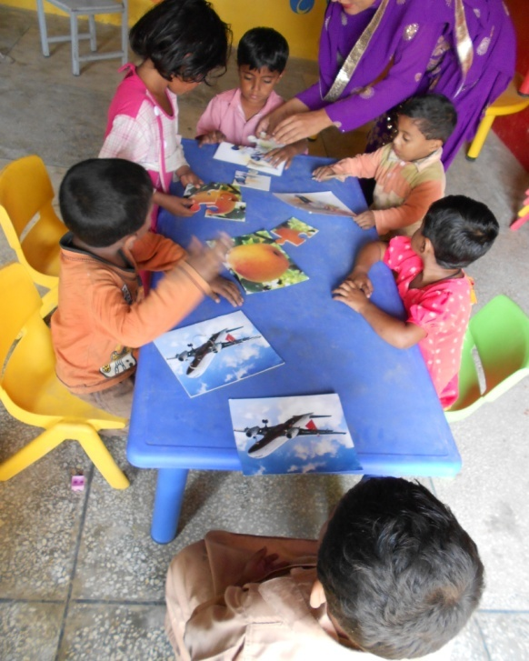
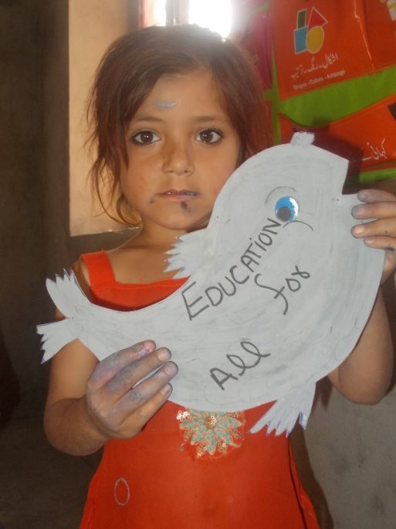
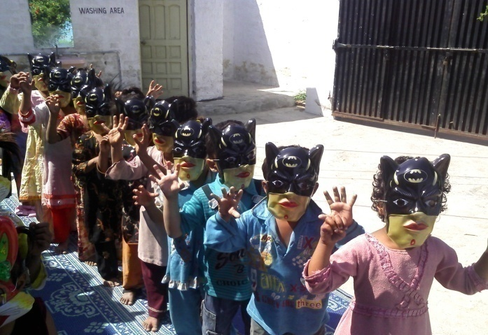
ECD Centre “Pahnjo Verho”
Learning through play
Health & hygiene

Slide 21
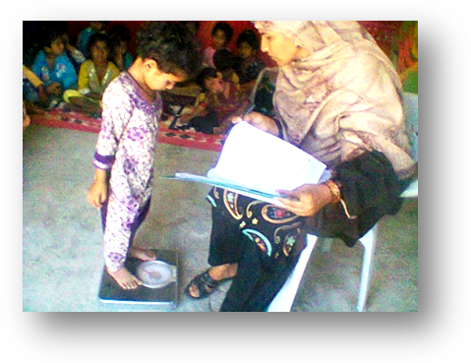
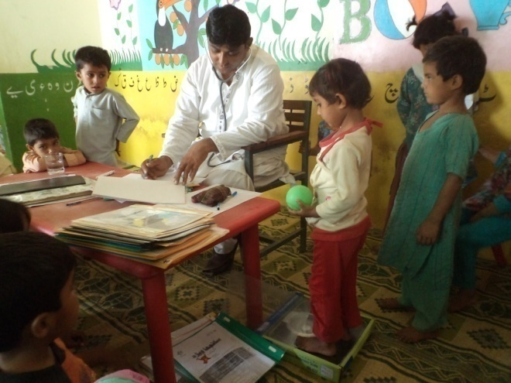
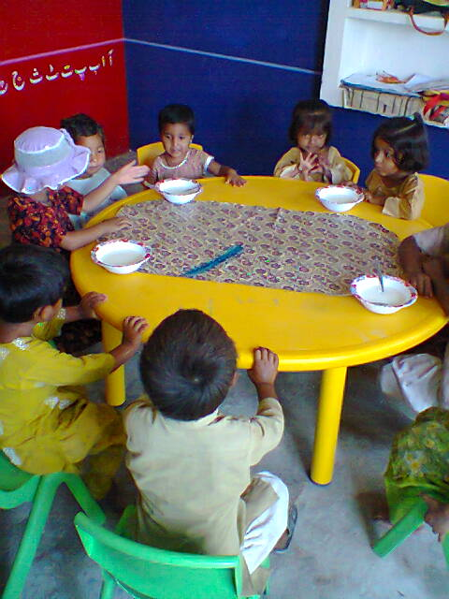
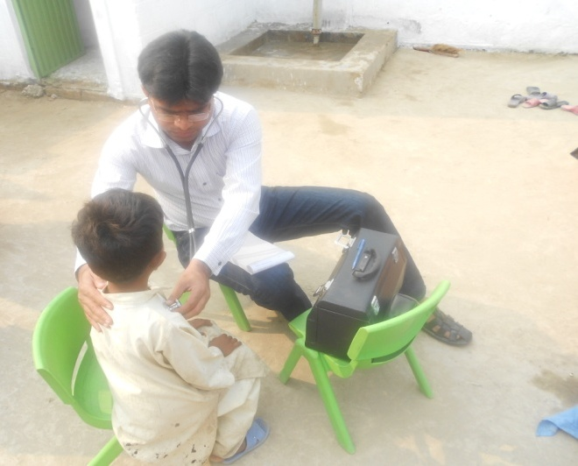
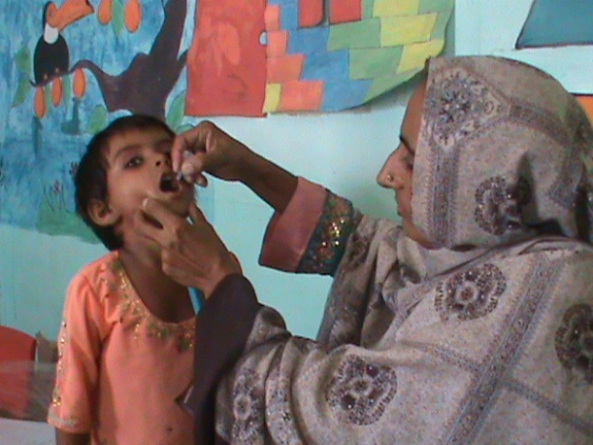
ECD Centre “Pahnjo Verho”
Sessions with mothers
Growth monitoring
Kitchen Gardening, nutritious meals & health
Medical Checkups, Early detection & referrals
Vaccination & age record

Slide 22
“CHILDREN, ESPECIALLY GIRLS AGED 2-12 HAVE ACCESS TO QUALITY EDUCATION WITH IMPROVED INFRASTRUCTURE AND SAFE LEARNING ENVIRONMENT”
    Thank you

